Slide 1

S J C INSTITUTE OF TECHNOLOGY
DEPARTMENT OF COMPUTER SCIENCE AND ENGINEERING
Synopsis On
“Tracking Waste Disposal and Generation of Fine to control and promote proper waste segregation”
PRESENTED BY
Kavyashree K S Keerthana S Nagashree C R Navya L
1SJ20CS068
1SJ20CS069
1SJ20CS092
1SJ20CS094
Coordinators
Dr. Seshaiah M , Dr. Srihari M R
Associate Professors
CSE,SJCIT
Under Guidance of
Prof Ashok K N
Assistant professor CSE,SJCIT
Head of the Department
Dr. Manjunatha kumar B H
Professor
CSE,SJCIT
Dept. of CSE, SJCIT

Slide 2
CONTENTS
ABSTRACT
INTRODUCTION
PROBLEM DOMAIN, PROBLEM STATEMENT AND DETAILED ANALYSIS
LITERATURE SURVEY
OBJECTIVES OF THE PROPOSED WORK
OUTCOMES OF THE PROPOSED WORK
METHODOLOGY
VIII. DESIGN
IX. IMPLEMENTATION

Slide 3
ABSTRACT
The metropolitan cities in India alone produce about 10 million tons of waste. That is, if left untreated, the waste materials will cause several types of pollution which are water, soil and air that destroy our ecosystem completely. People can avoid this madness by being waste conscious at an individual level. Lack of awareness and weak imposition of rules by authorities on separate household garbage pick-up are some reasons why many policies have failed to accomplish this. Thus, we aim to monitor and fine them whenever they don't obey the rules in segregating their household wastes. This project mainly deals with using web camera images to determine the percentage of non-segregating biodegradable from non-biodegradable waste during its collection by the municipal bodies for determining the fines based on improper disposal methods of waste products. One way of analyzing the proportion of non-segregated garbage is through Convolution Neural Networks (CNN), a deep learning algorithm.
Dept. of CSE, SJCIT
3

Slide 4

INTRODUCTION
India generates 133,760 tonnes of Municipal Solid Waste daily, but only collects 91,152 tonnes and treats 25,884 tonnes.
Per capita MSW generation varies from 0.17 kg in small towns to 0.62 kg in cities.
Despite social and economic progress, the country's Solid Waste Management systems haven't seen significant improvements.
Roughly 90% of leftover waste is dumped rather than properly landfilled, with urban waste generation set to increase to 0.7 kg per person daily by 2025.
Inadequate waste disposal leads to environmental and public health issues, including methane emissions, global warming, and water contamination.
Dept. of CSE, SJCIT
4

Slide 5
PROBLEM DOMAIN, PROBLEM STATEMENT AND DETAILED ANALYSIS
Problem Domain: Tracking Waste Disposal and Generation of Fine to control and promote proper waste segregation
Problem Statement: Develop a system to accurately identify and categorize materials based on their ability to naturally decompose or not, addressing environmental and health concerns. Utilize Deep Learning (CNN) for image-based classification of these materials.

Slide 6
DETAILED ANALYSIS
The project aims to develop an image classification system to accurately determine the percentages of biodegradable and non-biodegradable waste from pre-segregated waste images. It also imposes fines for incorrect disposal, contributing to efficient waste management and environmental sustainability. The methodology involves data collection, preprocessing, model implementation, training, testing, and post-processing.

Slide 7
LITERATURE SURVEY
Pushpakalambiga and Dr. Jasmine emphasize proper waste disposal, advocating for awareness and education, and promote the 3 R's: Recycle, Reuse, and Reduce.
Atik's paper focuses on using deep learning algorithms like ShuffleNet to classify biodegradable and non-biodegradable materials, achieving a high accuracy rate of 98.73%.
Mitra proposes using object detection software, specifically the Faster R-CNN model, for waste classification and identification, highlighting its accuracy compared to other models.
Menaka S proposes a machine learning approach, utilizing the Improved Faster Recurrent Convolutional Neural Network (IFRCNN) for waste segregation, achieving a precision of 96.23% to 98.15%.
Abdu and Mohd Noor conduct a survey on waste detection and classification using various deep learning models, discussing their applications and compiling benchmarked trash datasets to address challenges in waste management.
Dept. of CSE, SJCIT
7

Slide 8
METHODOLOGY
Data Collecting: Gathering images of waste items to build a dataset for training the classification model.
Data Pre-processing: Preparing the collected data by resizing, normalizing, and augmenting images to enhance the model's performance during training.
Model Implementation: Designing and constructing the image classification model using deep learning frameworks like TensorFlow and Keras.
Model Training: Training the implemented model on the preprocessed dataset to learn patterns and features that distinguish between biodegradable and non-biodegradable waste items.
Model Testing: Evaluating the trained model's performance on a separate test dataset to assess its accuracy and effectiveness in classifying waste images.
Fine Imposition: Imposing fines based on the classification results to incentivize proper waste disposal practices and promote environmental sustainability.
Dept. of CSE, SJCIT
8

Slide 9
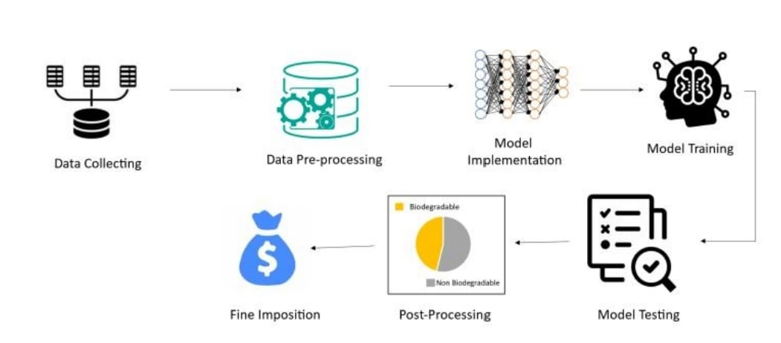
Figure : Methodology
Dept. of CSE, SJCIT
9

Slide 10
OBJECTIVES
Develop an image upload system for pre-segregated waste, emphasizing misclassification detection.
Utilize TensorFlow or Keras to create a precise algorithm for determining biodegradable and non-biodegradable percentages in waste images.
Set up a contamination threshold for identifying misclassified waste, integrating a fine-trigger mechanism for exceeding limits.
Create an intuitive interface using tools like Matplotlib or Tkinter for visualizing fine-related data, promoting user awareness.
Efficiently generate fines for misclassified waste instances, maintaining a user-friendly approach to encourage proper disposal practices.
Dept. of CSE, SJCIT
10

Slide 11
OUTCOMES
Enhanced accuracy in waste sorting through the implemented image upload system and advanced algorithm.
Timely identification and intervention for misclassified waste, enforcing fines when contamination thresholds are exceeded.
Increased user awareness and accountability due to the intuitive interface, fostering positive changes in waste disposal behavior.
Minimized adverse environmental impacts by efficiently generating fines for instances of misclassified waste
Dept. of CSE, SJCIT
11

Slide 12
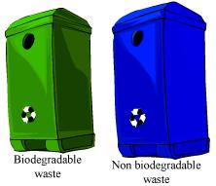

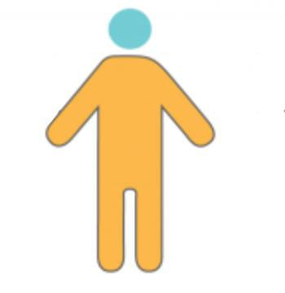


ARCHITECTURE OF THE PROPOSED SYSTEM
Upload the image
Biodegradable waste Bin
Input data analysis through CNN algorithm
Display of the fine generated in Tkinter window
user
Non-Biodegradable waste Bin
Upload the images

Slide 13
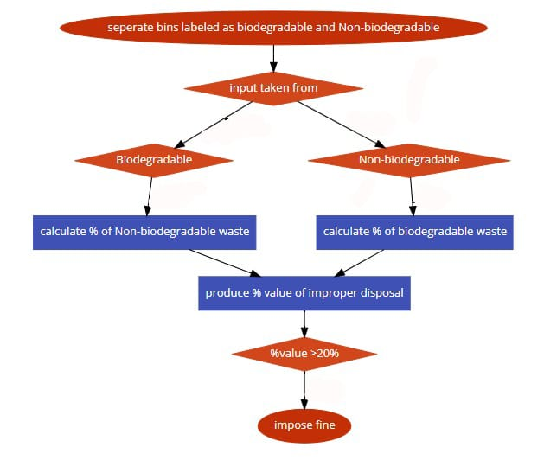
DATAFLOW DIAGRAM

Slide 14

USE CASE DIAGRAM
Physical system
Biodegradable waste bin
Capturing image
Upload the image
Provide input
System
Display calculated fine for wrong disposal
Analyze image
Output console
USER
Analyze image
Supply input
Non-Biodegradable waste bin
Upload the image
Capturing image
14

Slide 15
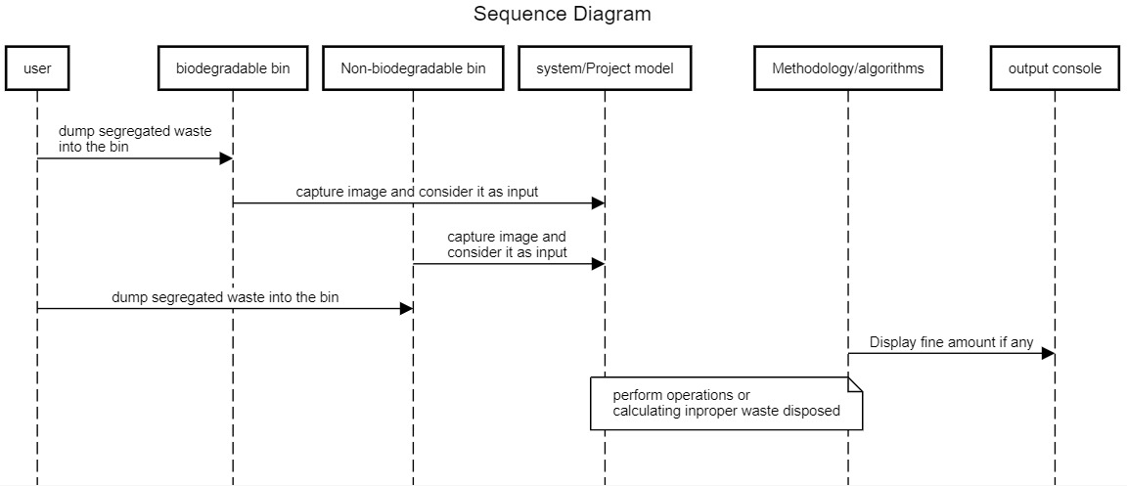
SEQUENCE DIAGRAM

Slide 16
MODULES SPLIT UP & EXPLANATION OF EACH MODULE
Data Preparation Module
This module is responsible for preparing the training and validation data before feeding it into the neural network.
It uses ImageDataGenerator from TensorFlow's Keras API to perform data augmentation and normalization.
The flow_from_directory method is used to load the data from directories and generate batches of augmented data.
Neural Network Architecture Module:
This module defines the architecture of the convolutional neural network (CNN) model.
The model consists of convolutional layers (Conv2D), pooling layers (MaxPooling2D), a flattening layer (Flatten), and fully connected layers (Dense).
Rectified Linear Unit (ReLU) activation function is used in the convolutional layers, and the Sigmoid activation function is used in the output layer for binary classification.

Slide 17
Model Training Module
This module compiles and trains the CNN model using the prepared data.
The model is compiled with the Adam optimizer, binary cross-entropy loss function, and accuracy metric.
The fit method is used to train the model for a specified number of epochs using the training data generated by the data preparation module.
Model Saving Module
After training, this module saves the trained model to a specified file path.
The save method of the model object is used to save the model in Hierarchical Data Format (HDF5) format, which can be loaded later for inference or further training.

Slide 18
Image Classification Module
This module loads the pre-trained model for image classification.
It defines a function (classify_image) to preprocess an input image, classify it using the loaded model, and return the classification results (percentage of biodegradable and non-biodegradable waste). Graphical User Interface (GUI) Module
This module provides a graphical interface for users to interact with the image classification system.
It uses the Tkinter library to create a window-based application with buttons, labels, and canvas for displaying images and results.
Users can upload images, classify them, and view the classification results along with visualizations such as pie charts.

Slide 19
ALGORITHM USED IN MODULES
NEURAL NETWORK ARCHITECTURE MODULE
Algorithm used CNN
# Build your CNN model
model = Sequential()
model.add(Conv2D(32, (3, 3), input_shape=(224, 224, 3), activation='relu'))
model.add(MaxPooling2D(pool_size=(2, 2)))
model.add(Flatten())
model.add(Dense(units=128, activation='relu'))
model.add(Dense(units=1, activation='sigmoid'))

Slide 20
IMAGE CLASSIFICATION MODULE:
Algorithm used CNN
# Function to classify an image and calculate the percentage of waste
@tf.function
def classify_image(image_array):
# Ensure the input array has the correct shape and dtype
image_array = tf.convert_to_tensor(image_array, dtype=tf.float32)
image_array = tf.expand_dims(image_array, axis=0) / 255.0
# Use the model as a callable function
prediction = model(image_array)
percentage_biodegradable = (1 - prediction[0][0]) * 100
percentage_non_biodegradable = prediction[0][0] * 100
return percentage_biodegradable, percentage_non_biodegradable

Slide 21
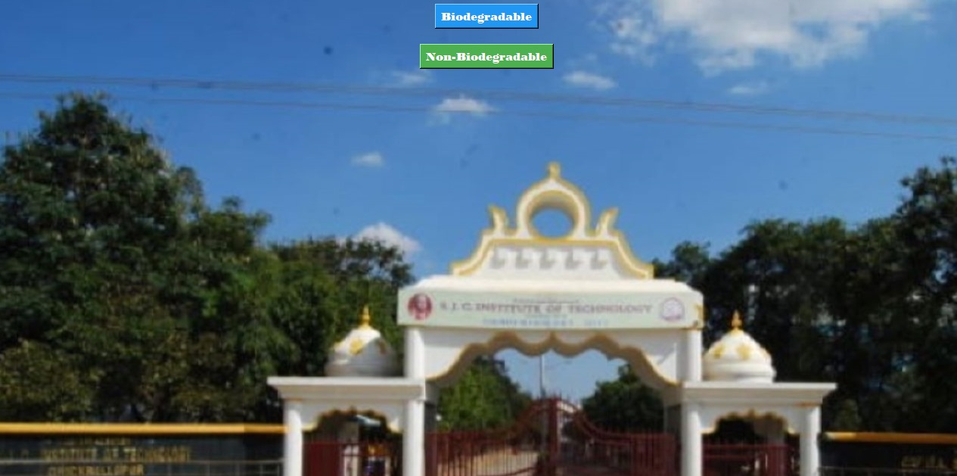
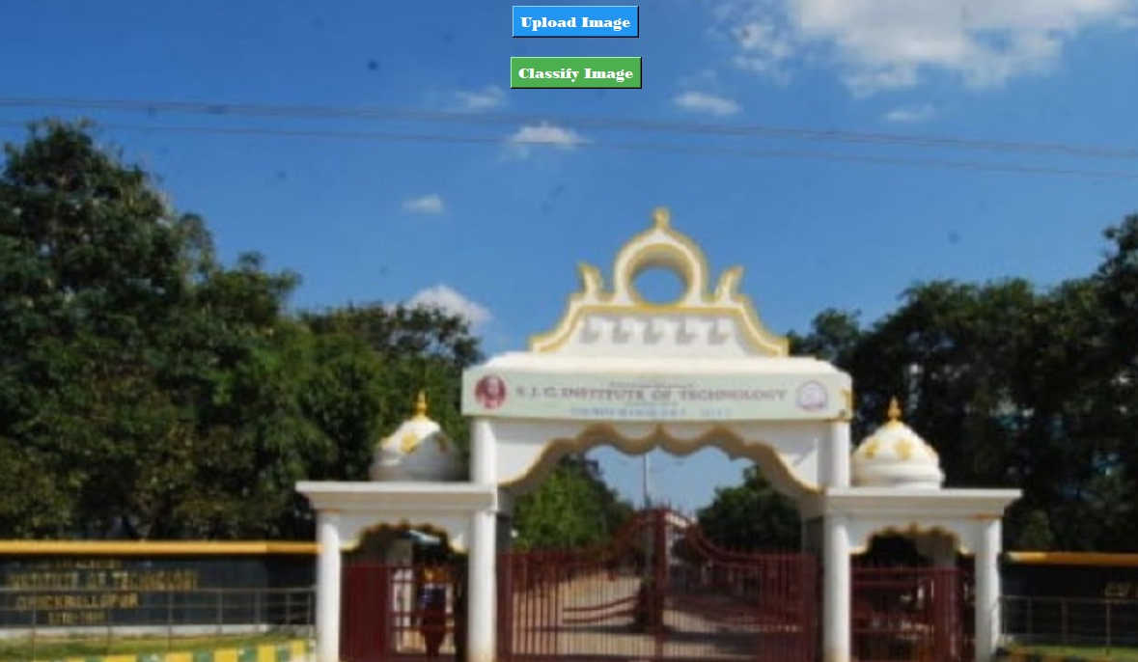
DEMONSTRATION OF WORKING MODULES
FIG1 INITIAL SELECTION INTERFACE
FIG2 UPLOAD AND CLASSIFY BUTTONS

Slide 22
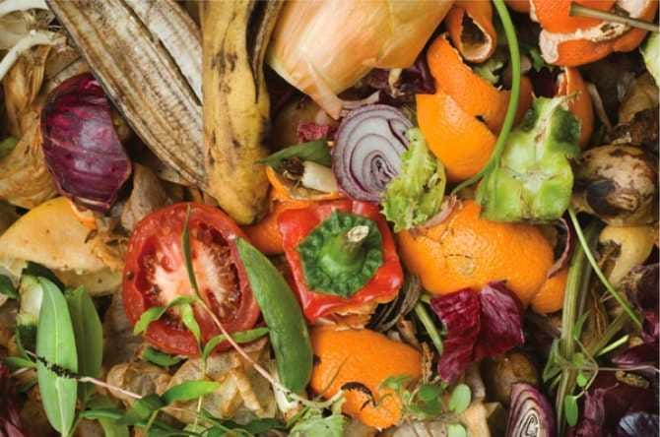
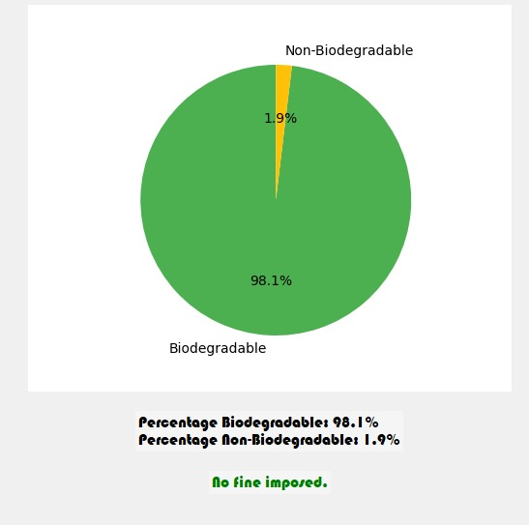
FIG3 BIODEGRADABLE INPUT IMAGE UPLOAD
FIG4 OUTPUT OF FIG3
Dept. of CSE, SJCIT
22

Slide 23
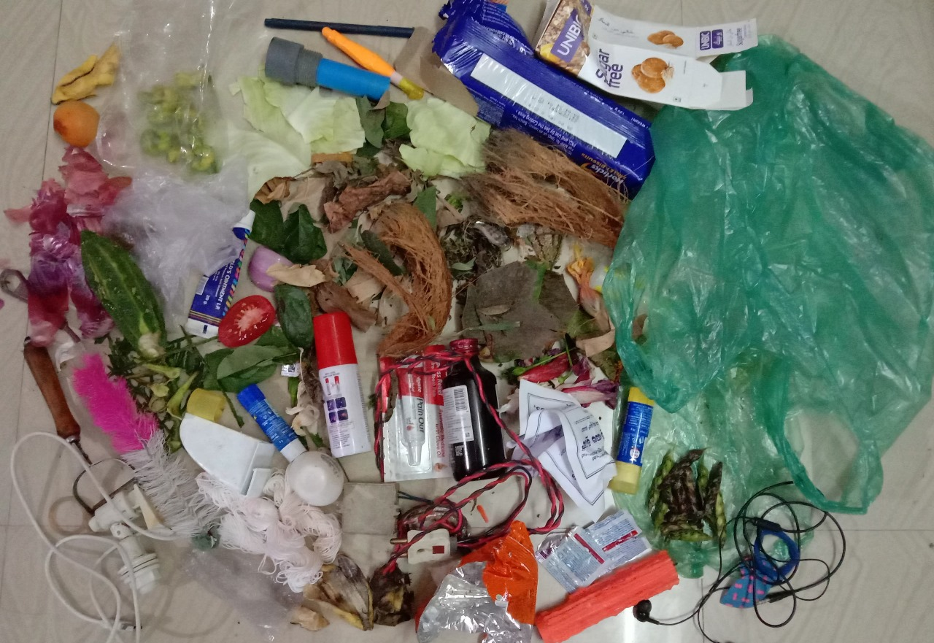
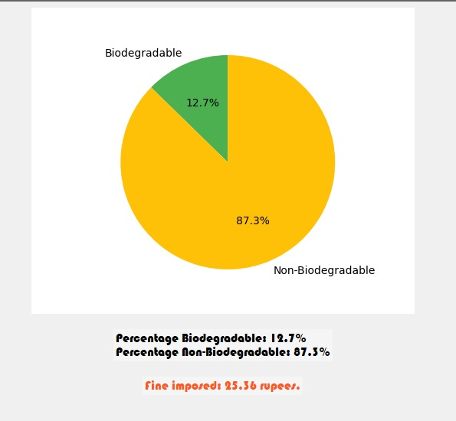
FIG5 IMAGE UPLOADED AS NONBIODEGRADABLE
FIG6 OUTPUT OF FIG5
Dept. of CSE, SJCIT
23

Slide 24
CONCLUSION
Developed a waste classification system using deep learning and a user-friendly interface.
Prepared and preprocessed image data using TensorFlow and Keras.
Designed a CNN architecture for accurate waste item classification.
Trained and saved the model for efficient future use.
Created a GUI for easy interaction, promoting sustainable waste management practices.

Slide 25
ACTION PLAN
Enhance GUI:
Improve user interface for better user experience.
Implement visual enhancements to make the application more appealing.
2. Collect More Waste Images:
Focus on capturing images from various sources and environments
Dept. of CSE, SJCIT
25

